Slide 1
Lecture 15
Decentralized Applications (DApps)

Slide 2
What we have achieved so far?
We know what Ethereum is and how it is different from the Bitcoin.
We have basic understanding about the Smart contracts.
We know how to code, deploy and interact with smart contracts.
We have setup development environment and know how to setup and use Metamask, Ganache, Remix, Truffle ...

Slide 3
Course Project ☺
Build a decentralized application
You need to choose an innovative use-case justifying the need for a blockchain based solution. You will use Ethereum framework, and you need to thus write smart contract(s) in Solidity for the backend logic and build a Web application as a front-end in React.
Group size < 4
Group Information: 20th November 2023
Idea submission: 24th November 2023
Submission Deadline: 03rd December 2023

Slide 4
Decentralized Applications (DApps)
Ethereum vision is much broader than “smart contracts”: no less than reinventing the web and creating a new world of DApps, aptly called web3.
Smart contracts decentralize the controlling logic and payment functions of applications.
DApps are about decentralizing all other aspects of an application: storage, messaging, naming, etc.

Slide 5
Decentralized Applications (DApps)
A DApp is an application that is mostly or entirely decentralized.
  Backend software (application logic)
  Frontend software
  Storage, communication ..

Slide 6
Advantages
Resiliency - no downtime, available as long as platform is operating.
Transparency - Everyone can inspect the code and be more sure about its function. Any interaction with the DApp will be stored forever in the blockchain.
Censorship resistance - As long as a user has access to an Ethereum node the user will always be able to interact with a DApp without interference from any centralized control.

Slide 7
Decentralized Applications (DApps)
In practice, there are very few truly decentralized apps—most still rely on centralized services and servers for some part of their operation.
Let us start with the frontend for our decentralized application logic. To keep things simple, we will use our simplestorage smart contract.
Many alternatives exist using web3.js, we will use React.

Slide 8
What is React?
React is a JavaScript library created by Facebook.
React is a tool for building and using UI components.

Slide 9
ReactJs or ReactNative?
ReactJS is a JavaScript library for building user interfaces and web applications.
React Native is a mobile framework allowing you to build mobile applications for different platforms. You can use ReactJS to build reusable components.

Slide 10
How does React Work?
React creates a VIRTUAL DOM in memory.
React only changes what needs to be changed!

Slide 11

HTML DOM (Document Object Model)
The DOM model is constructed as a tree of Objects on page load.
The HTML DOM is a standard for how to get, change, add, or delete HTML elements.

Slide 12
Javascript and DOM
JavaScript can change all the HTML elements in the page
JavaScript can change all the HTML attributes in the page
JavaScript can change all the CSS styles in the page
JavaScript can remove existing HTML elements and attributes
JavaScript can add new HTML elements and attributes
JavaScript can react to all existing HTML events in the page
JavaScript can create new HTML events in the page

Slide 13
Manipulating DOM using Javascript
It can be done but inefficient to do so.
React creates a virtual DOM in memory, where it does all the necessary manipulating, before making the changes in the browser DOM.
React finds out what changes have been made, and changes only what needs to be changed.

Slide 14
Getting started
React components can be added to an existing html page, using script tag

Slide 15
Getting started
The easiest and managed approach to create a new react app is using the package create-react-app.
Let us install it first using npm install -g create-react-app
We can then create a new react app using
create-react-app myfirstreact

Slide 16
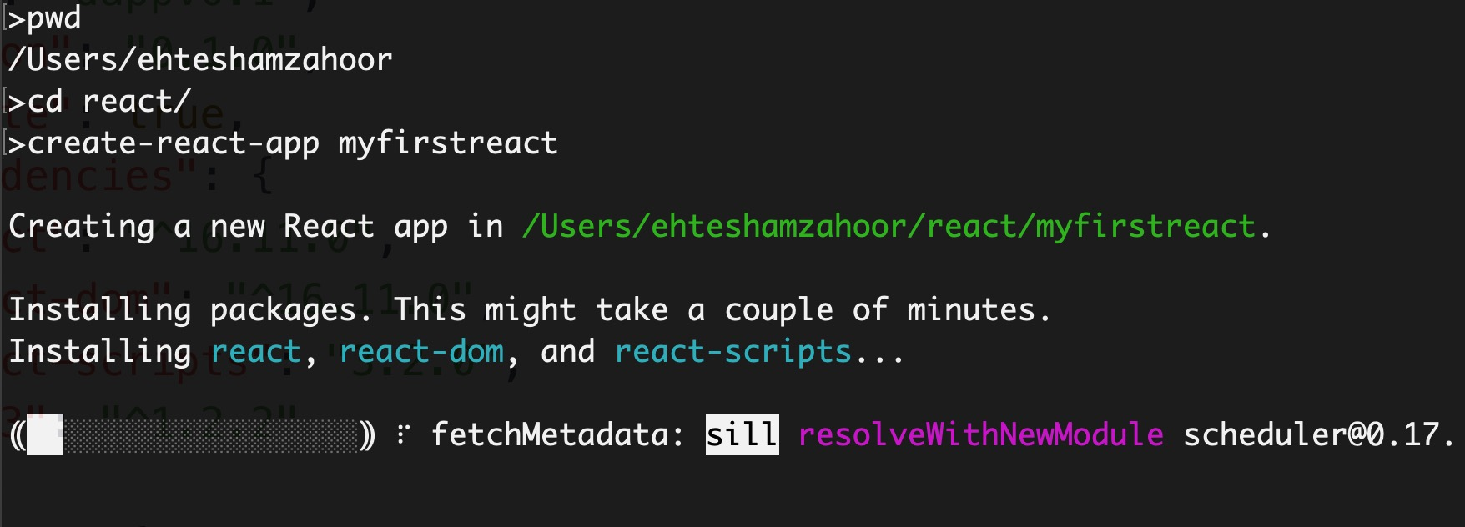
Getting started

Slide 17
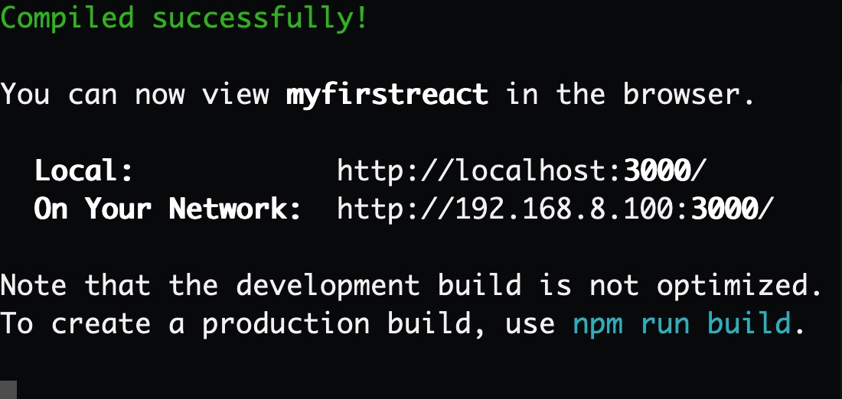
Getting started
Once setup is complete, browse to the directory and launch the react app using npm start

Slide 18
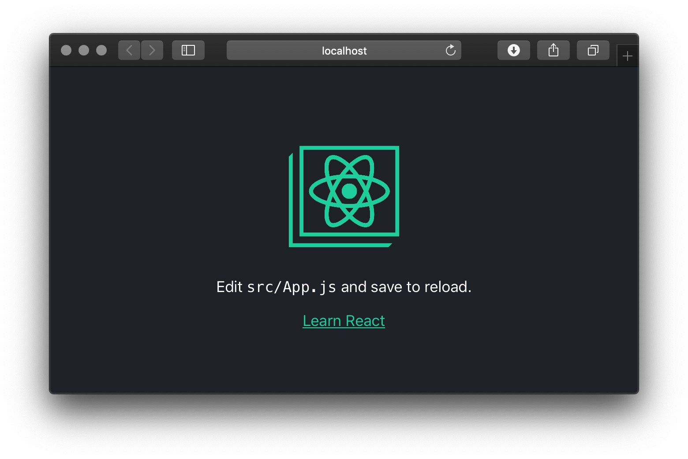
Getting started

Slide 19
Getting started
Congratulations, you have a working react environment.
As the app says, go on and change the app.js and any changes saved in the js file would be automatically reflected on the page.

Slide 20
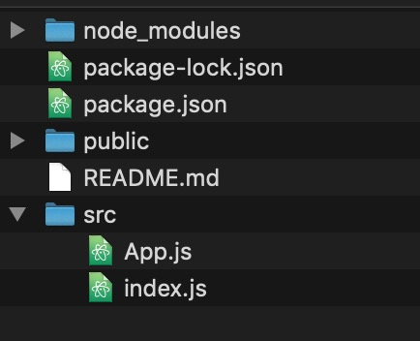
How does it work?
Let us first simplify the structure.
Remove all other files in the src folder, other than the one shown below:

Slide 21
Updating index.js
import React from 'react';
import ReactDOM from 'react-dom';
let myelement = <h1>Hello World</h1>;
ReactDOM.render(myelement, document.getElementById('root'));

Slide 22
React components – App.js
import React, {Component} from 'react';
class App extends Component {
render() {
return (
<div>
<h1>Hello World!</h1>
</div>
); }
}
export default App;

Slide 23
React components – index.js
import React from 'react';
import ReactDOM from 'react-dom';
import App from './App.js'
ReactDOM.render(<App />, document.getElementById('root'));

Slide 24
Using existing components
npm install react-intense
import React from 'react';
import ReactDOM from 'react-dom';
import ReactIntense from 'react-intense'
import birdimage from './bird.jpg';
let myelement = <ReactIntense src={birdimage} />
ReactDOM.render(myelement, document.getElementById('root'));

Slide 25
Using existing components
npm install @material-ui/core
import React from 'react';
import ReactDOM from 'react-dom';
import Button from '@material-ui/core/Button';
let myelement =
<Button variant="contained" color="primary">
Hello World
</Button>;
ReactDOM.render(myelement, document.getElementById('root'));

Slide 26
Component States
React components have a built-in state object.
The state object is where you store property values that belongs to the component.
When the state object changes, the component re-renders.

Slide 27
import React from 'react';
import ReactDOM from 'react-dom';
class Car extends React.Component {
constructor(props) {
super(props);
this.state = {
brand: "Ford",
model: "Mustang",
};
}
render() {
return (
<div>
<h1>My {this.state.brand}</h1>
<p> It is a {this.state.model} </p>
</div>
);
}
}
export default Car

Slide 28
web3.js
web3.js is a collection of libraries which allow you to interact with a local or remote ethereum node.
How to install? npm install web3 --save

Slide 29
Adding web3.js to React
import Web3 from 'web3’
const web3 = new Web3(Web3.givenProvider || "http://localhost:7545")
const accounts = await web3.eth.getAccounts()

Slide 30
...back to our react app
Let us get back to where we started. index.js is as below
import React from 'react';
import ReactDOM from 'react-dom';
import App from './App.js'
ReactDOM.render(<App />, document.getElementById('root'));

Slide 31
...back to our react app
Let us get back to where we started. App.js is as below
import React, {Component} from 'react';
class App extends Component {
render() {
return (
<h1>Hello World!</h1>
); }
}
export default App;

Slide 32
Adding web3.js
import React, {Component} from 'react';
import Web3 from 'web3'
class App extends Component {
constructor() {
super()
this.state = { account: '' }
}
componentDidMount() {
this.loadBlockchainData()
}
async loadBlockchainData() {
const web3 = new Web3(Web3.givenProvider || "http://localhost:7545")
const accounts = await web3.eth.getAccounts()
this.setState({ account: accounts[0] })
}
render() {
return (
<h1>{this.state.account}</h1>
); }
}
export default App;

Slide 33
Adding web3.js
So far so good. We are able to connect with Ganache and can show the account[0].
Notice that we are creating a state variable named account. It is populated once and can be used multiple times.

Slide 34
SimpleStorage contract instance
In order to get an instance of deployed contract, we need its address and ABI.
An application binary interface is an interface between two program modules. An Ethereum smart contract is bytecode deployed on the Ethereum blockchain. There could be several functions in a contract. An ABI is necessary so that you can specify which function in the contract to invoke, as well as get a guarantee that the function will return data in the format you are expecting.

Slide 35
SimpleStorage contract instance
How to get ABI for our contract?
We have learned that truffle uses the build directory for compiled contract code. There is a file named SimpleStorage.json there.
It contains many things including the ABI

Slide 36
SimpleStorage contract ABI
[
{ "constant": false,
"inputs": [
{ "name": "x",
"type": "uint256" }
],
"name": "set",
"outputs": [],
"payable": false,
"stateMutability": "nonpayable",
"type": "function" },
{
"constant": true,
"inputs": [],
"name": "get",
"outputs": [
{ "name": "",
"type": "uint256" }

Slide 37
SimpleStorage contract instance
Let us place the ABI and contract address in a new file named config.js
export const SIMP_STORAGE_ADDRESS = '0x8b6C88E2aA47d15eF2FD29252481C2c6B27403DC'
export const SIMP_STORAGE_ABI = [
{
"constant": false,
"inputs": [
{
"name": "x",
"type": "uint256"
}
],
...

Slide 38
import React, {Component} from 'react';
import Web3 from 'web3'
import {SIMP_STORAGE_ADDRESS, SIMP_STORAGE_ABI} from './config.js'
class App extends Component {
constructor() {
super()
this.state = { account: '', simpcontract:'', value:'' }
}
componentDidMount() {
this.loadBlockchainData()
}
async loadBlockchainData() {
const web3 = new Web3(Web3.givenProvider || "http://localhost:7545")
const accounts = await web3.eth.getAccounts()
this.setState({ account: accounts[0] })
const simpstorage = new web3.eth.Contract(SIMP_STORAGE_ABI, SIMP_STORAGE_ADDRESS);
this.setState({ simpcontract: simpstorage })
const value = await simpstorage.methods.get().call()
this.setState({ value: value })
}
render() {
return (
<h2>{this.state.value}</h2> ); }
}
export default App;

Slide 39
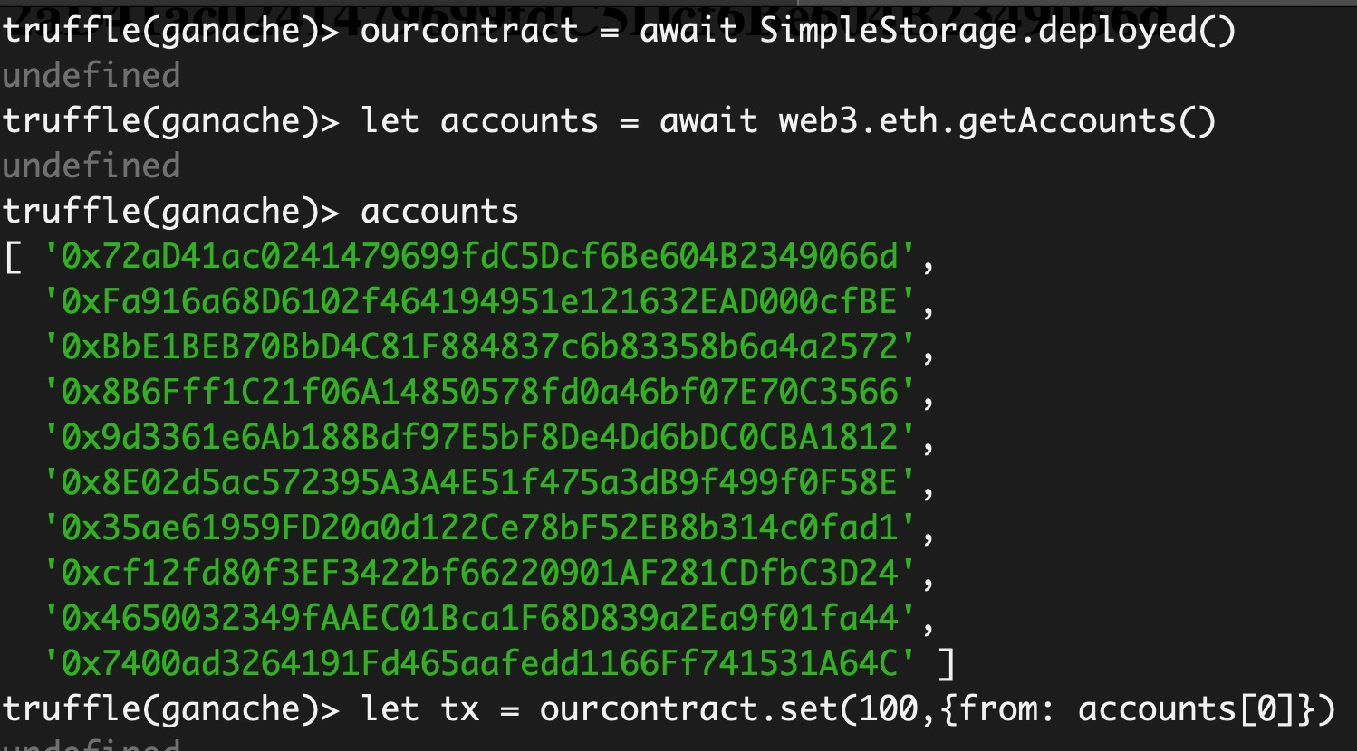
What value do we get?
If zero, means we havent set() any value.
How can we do that?

Slide 40
How about setting the value?
We can call the set method on our contract.
We need to render the html form with submit button and handle the call.

Slide 41
How about setting the value?
render() {
return (
<div>
<p>Your account: {this.state.account}</p>
<p>The value of X: {this.state.value}</p>
<form onSubmit={(event) => {
event.preventDefault()
const valueField = new FormData(event.target).get("valueField");
this.state.simpcontract.methods.set(valueField).send({ from: this.state.account })
this.loadBlockchainData()
}}>
<input id="field" name ="valueField" type="text" required />
<input type="submit" hidden="" />
</form>
</div> );
}

Slide 42
Questions?

